Slide 1
Chapter No.4 Secondary Storage Devices

Slide 2
Optical Storage Devices

Slide 3
Optical storage Devices
Optical storage systems store and read data using light, often storing information on what is called an optical disk. The most popular types of optical storage devices are drives that read and write CDs, DVDs and Blu-ray disks. Scientists continue to explore ways to cram more data onto disks that can fit into a compact space.

Slide 4
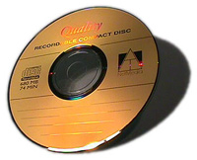
CD ROM
CD stands for "Compact Disc Read-Only Memory." A CD-ROM is a CD that can be read by a machine with an optical drive.
The "ROM" part of the word means that the data on the disk is "read-only" or cannot be changed or erased. The first CD-ROMs could carry around 600 MB of data.
CD-ROM is typically used to store software programs. CDs can store audio and video data, as well as text and program instructions

Slide 5
CD ROM
During the 1990s, CD-ROMs were popularly used to distribute software and data for computers and fourth generation video game consoles.
Early CD-ROM drives were called single speed, and read data at a rate of 150 KBps. (Hard disks transfer data at rates of 5 – 15 MBps). CD-ROM drives now can transfer data at speeds of up to 7800 KBps. Data transfer speeds are getting faster.

Slide 6
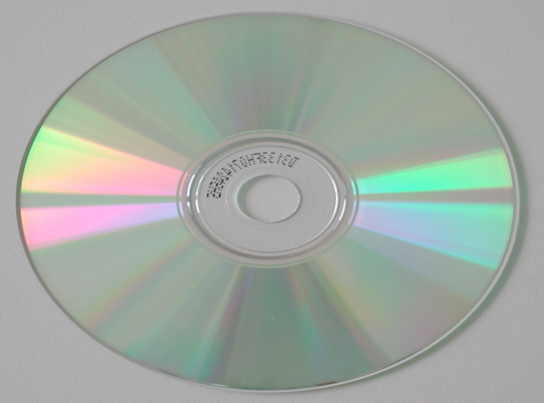
CD-R
CD-R (CD-recordable) allows end users to record their own data on CDs. Data can be burned onto these once and thereafter cannot be changed.
This makes CD-Rs great for permanent backup.
The CD-R is write once, read many.
The dye layer allows writing of data to this disk.

Slide 7
CD-RW
CD-RW (CD rewriteable).
These became available in 1997.
While a prerecorded CD has its information permanently stamped into its polycarbonate plastic substrate layer, a CD-RW disc contains a phase-change alloy recording layer.
An infra-red laser beam is used to heat (at 400ºC) and melt, the crystallized recording layer into a fluid state or to freeze it at a lower temperature back to its crystalline state.
In this way previous data is ‘erased’ and new data can be written (burned).

Slide 8
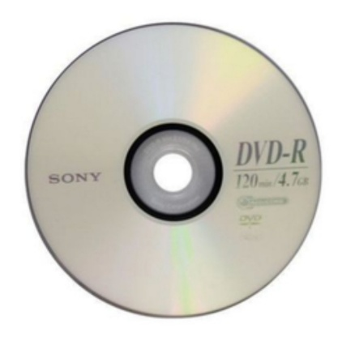
DVD-ROM
Digital versatile disc-read only memory (DVD-ROM).
The first DVD-ROMs were produced in Japan in November 1996. It was launched in the United States in March 1997.
It is a read-only digital versatile disc (DVD) commonly used for storing large software applications.

Slide 9
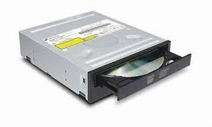
DVD ROM
It is similar to a compact disk-read only memory (CD-ROM) but has a larger capacity.
A DVD-ROM stores about 4.38 GB of data. Normally, a CD-ROM stores 650 MB of data.
A DVD-ROM indefinitely holds data files that cannot be modified, overwritten or erased.

